Slide 1
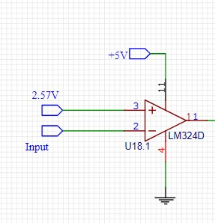
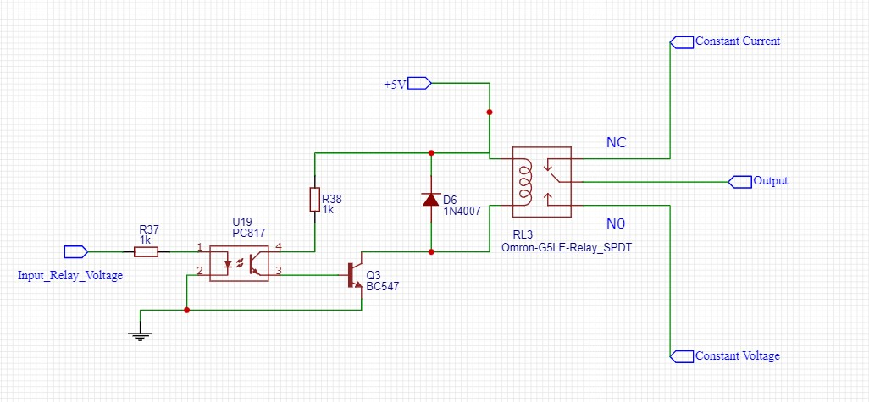
1) Comparator
Switching
Method - 1
If Battery voltage < 25.7 V, Comparator will produce 0V.
If Battery voltage > 25.7 V, Comparator will produce 5V.
2) 5V relay
If Comparator output voltage = 0V ,
initially relay will connect constant current mode connection.
If Comparator output voltage = 5V ,
relay will connect constant voltage mode connection.

Slide 2
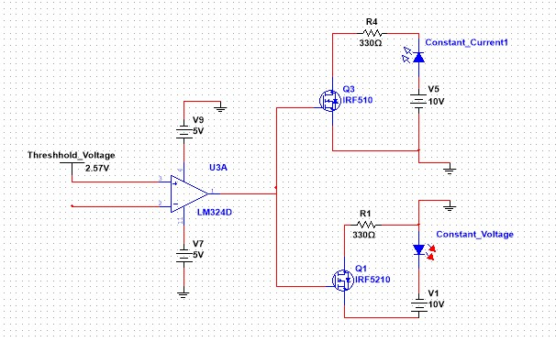
Switching
Method – 2
Using Power MOSFETs to control the constant current and constant voltage part.
If Battery voltage > 25.7 V, Comparator will produce 5V. So inially, N-MOSFET will connect constant current mode connection.
If Battery voltage < 25.7 V, Comparator will produce -5V. So P-MOSFET will connect constant current mode connection

